Slide 1
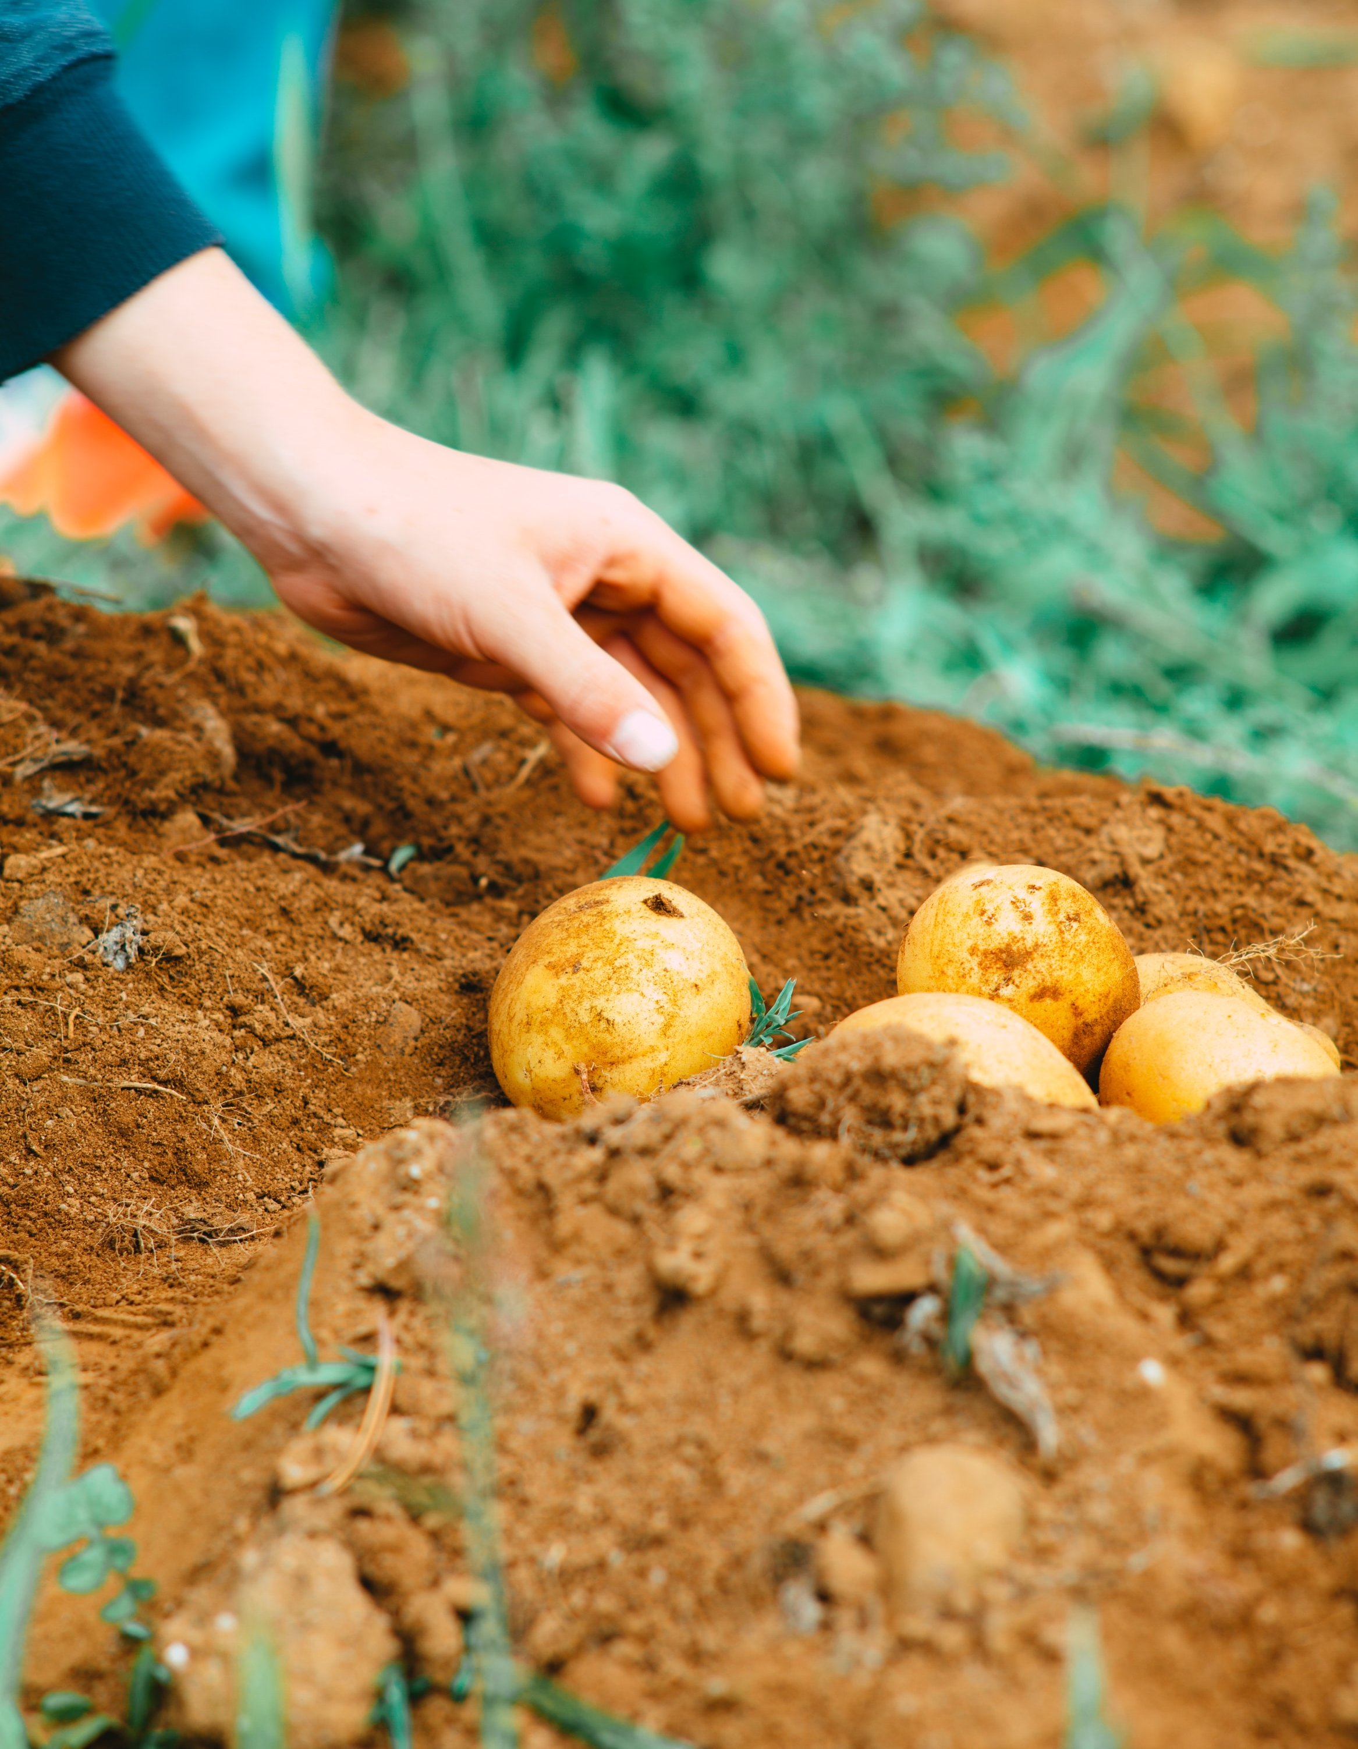

Different Ways to Cook Potatoes
By: Mandy Lubinski
Title
Overview
Baked
French Fries
Hashbrowns
Mashed
Scalloped
Smashed
Summary
Notes:
This is a good design template choice for my topic because it is simple and features the color brown, which blends nicely with the pictures of potatoes that I’ve inserted.
I modified the top level master slide by adding a background color and drop shadow to the footer.
I decided to use a picture of potatoes on a farm/raw in order to not show bias towards any one kind of cooked potato in the title slide.

Slide 2
Overview
Sources
French Fries
Hashbrowns
Scalloped
Baked
Mashed
Smashed
Title
Overview
Baked
French Fries
Hashbrowns
Mashed
Scalloped
Smashed
Summary
Notes:
I went with a smart art because I liked how it looked over having an image blurred in the background (it seemed a bit too distracting).

Slide 3
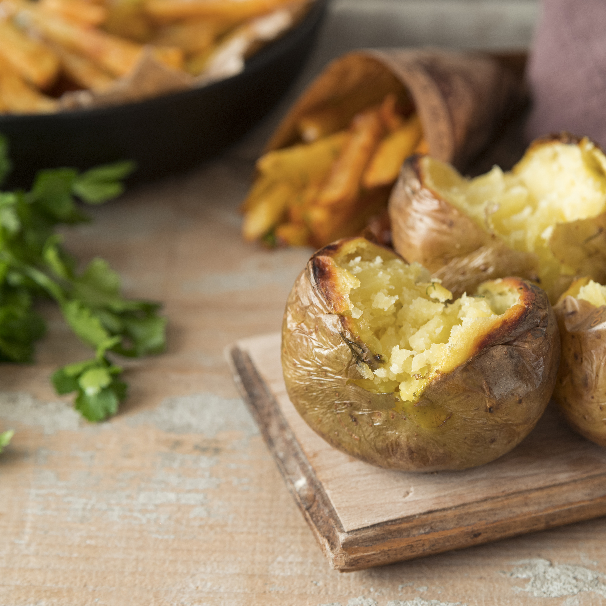
Baked
Title
Overview
Baked
French Fries
Hashbrowns
Mashed
Scalloped
Smashed
Summary
Notes:
For all of the body slides about the different types of ways to cook potatoes I liked the strong visual of having an image of that type of cooked potato as the entire slide with a text box stating the type in words.

Slide 4
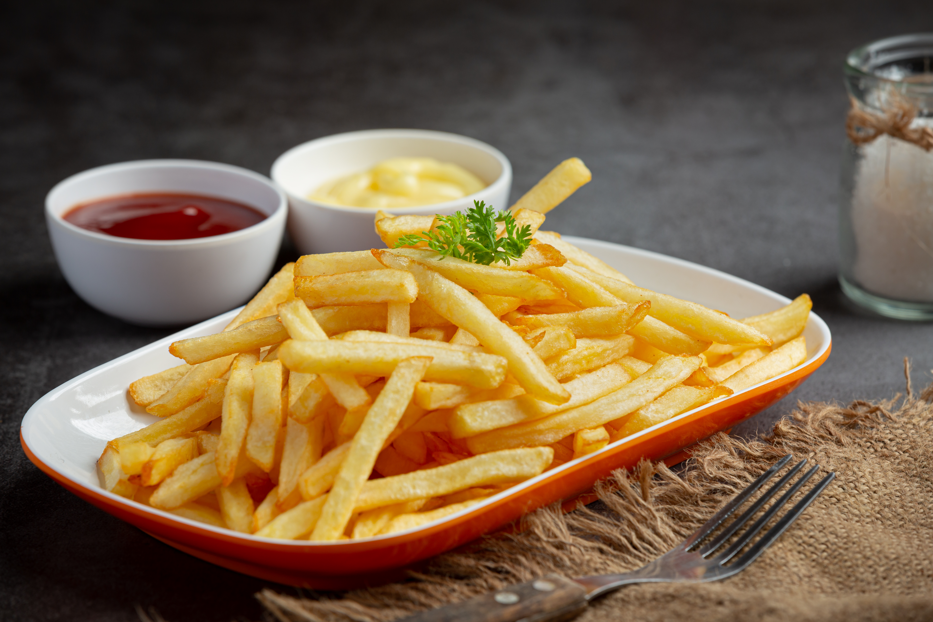
French Fries
Title
Overview
Baked
French Fries
Hashbrowns
Mashed
Scalloped
Smashed
Summary

Slide 5
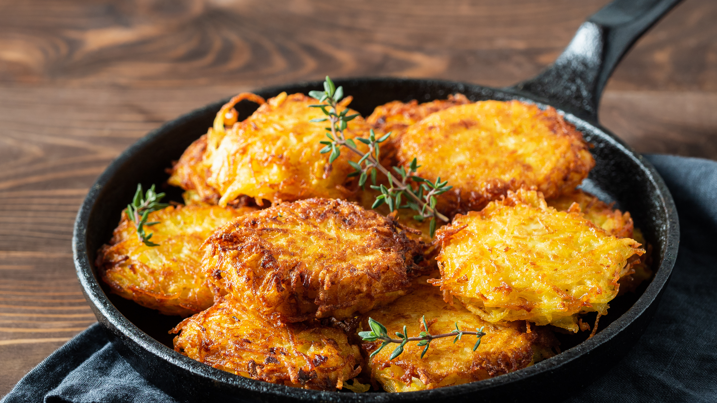
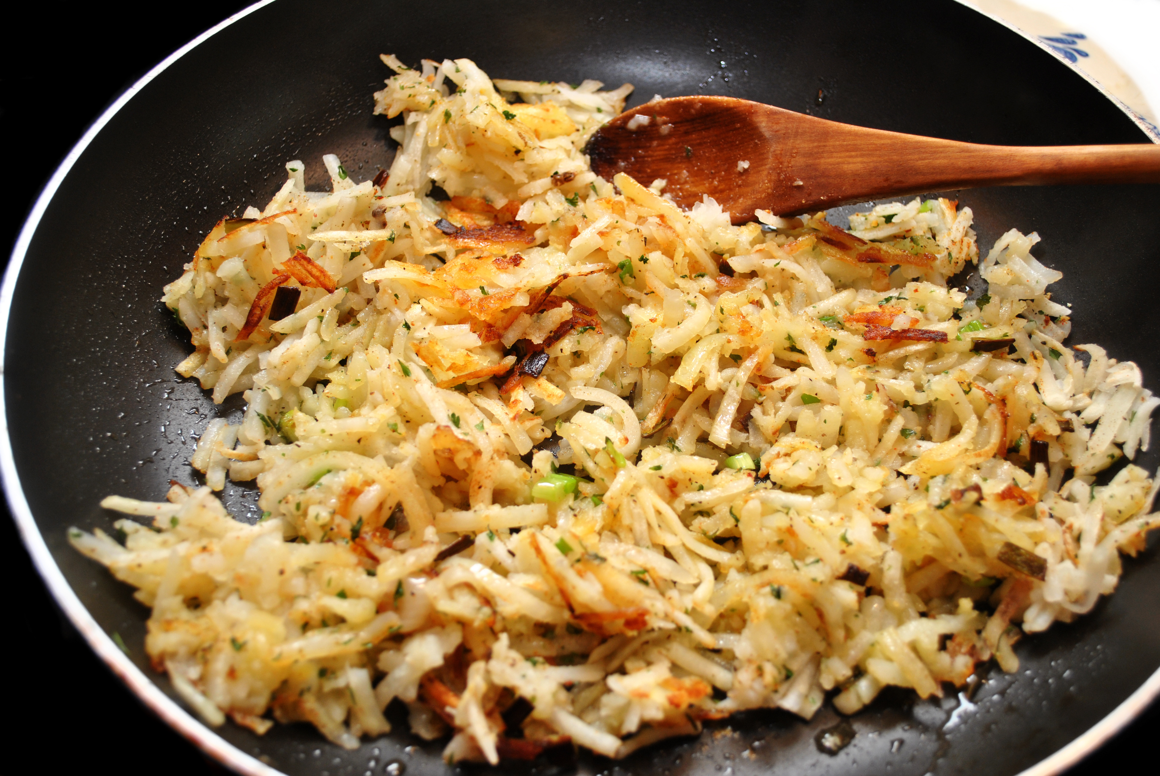
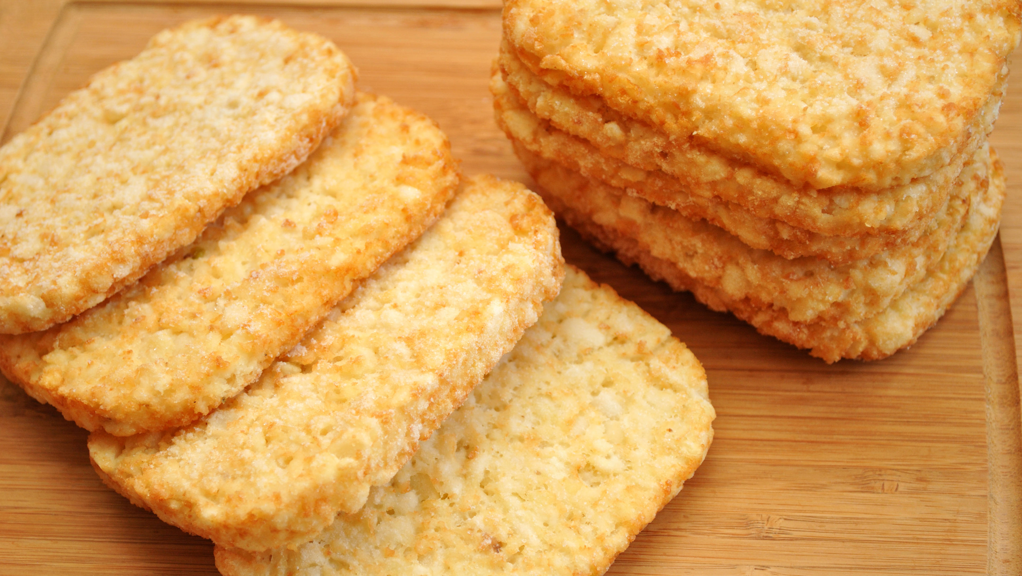
Hashbrowns
Title
Overview
Baked
French Fries
Hashbrowns
Mashed
Scalloped
Smashed
Summary
Notes:
Since hashbrowns are often cooked two different ways I would include both while also utilizing animations in order to do so to keep with the picture is the entire slide theme.

Slide 6
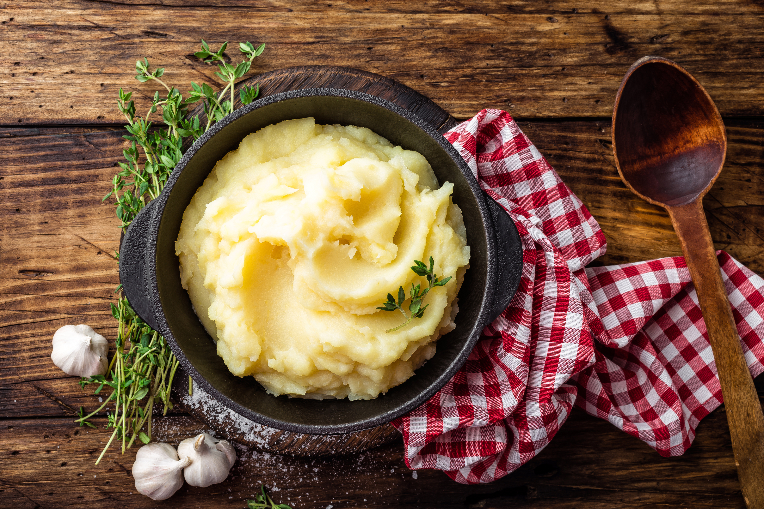
Mashed
Title
Overview
Baked
French Fries
Hashbrowns
Mashed
Scalloped
Smashed
Summary

Slide 7
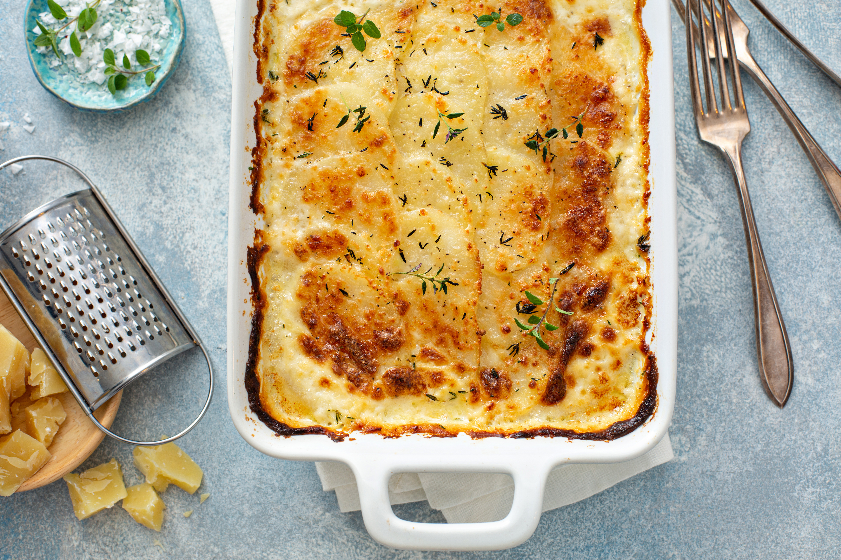
Scalloped
Title
Overview
Baked
French Fries
Hashbrowns
Mashed
Scalloped
Smashed
Summary

Slide 8
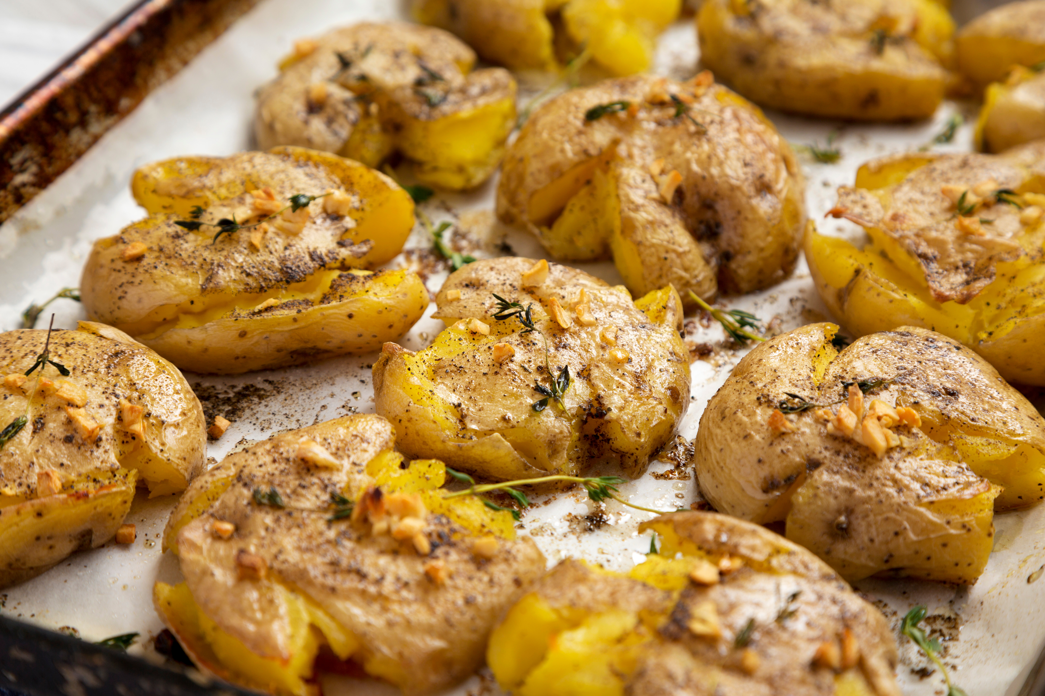
Smashed
Title
Overview
Baked
French Fries
Hashbrowns
Mashed
Scalloped
Smashed
Summary

Slide 9
Summary
Six ways to prepare potatoes are:
All potatoes are great!
Baked
French fries
Hashbrowns
Mashed
Scalloped
Smashed
Title
Overview
Baked
French Fries
Hashbrowns
Mashed
Scalloped
Smashed
Summary
Notes:
Again, I went with a smart art because I found it more pleasing to look at versus bullet points with a faded image background.

Slide 10
Sources
A list of different ways to cook potatoes
Origin of French fries
Go Back
Notes:
I demonstrated the ability to have a different background using this slide.
I demonstrated the ability to make objects animate in using this slide.
I demonstrated the ability to use a slide transition using this slide.
I demonstrated the ability to hyperlink an object to something outside this presentation using this slide.

